Slide 1

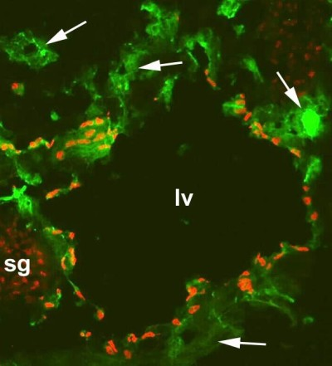
ReliaTech GmbH
Staining with anti-CD31 and anti-human Prox-1
Immunofluorescence with a frozen sections of a mouse embryo at day 13.5 with anti-CD31 [green] and anti-human Prox-1 [red] (RT #102-PA32S-RT). It shows a large lymphatic vessel (lv), blood vessels (arrows) and a sympathetic ganglion (sg) which is also positiv for Prox-1 (Fig.
The experiment was performed by PD. Dr. Jörg Wilting, Pädiatrie I, Zentrum für Kinderheilkunde und Jugendmedizin in Göttingen, Germany.
http://www.reliatech.de / orders@reliatech.de

Slide 2
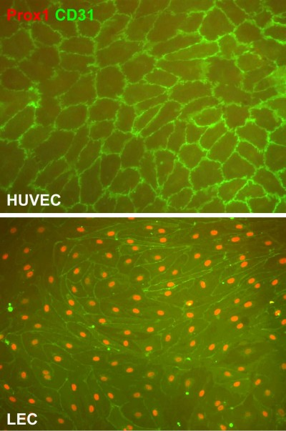
Staining with anti-CD31 and anti-human Prox-1
Immunofluorescence with a frozen sections of a lymphangiom with anti-CD31 [green] and anti-human Prox-1 [red] (RT #102-PA30S-RT).
The experiment was performed by PD. Dr. Jörg Wilting, Pädiatrie I, Zentrum für Kinderheilkunde und Jugendmedizin in Göttingen, Germany.

